Slide 1

Image processing: segmentation Lecture 7 by Anna Levant, PhD

Slide 2
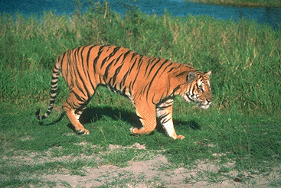
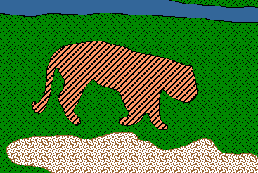
Image Segmentation
Goal: identify groups of pixels that go together
Pixels are grouped because they share some local property (gray level, color, texture, motion, etc.)
Slide credit: Steve Seitz, Kristen Grauman

Slide 3
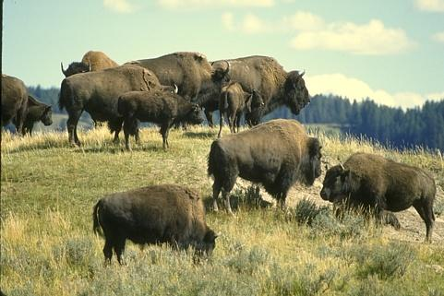
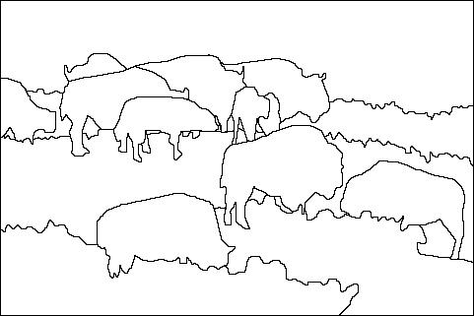
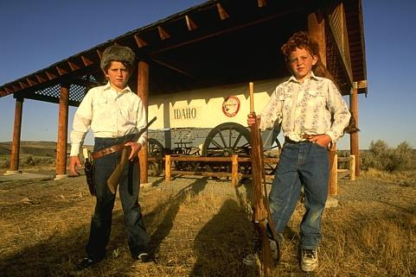
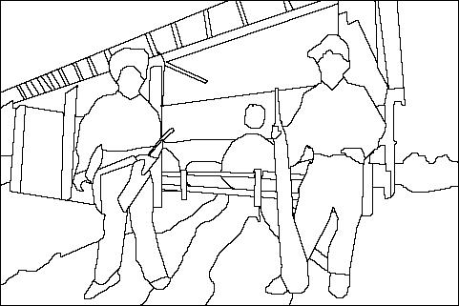
Why would we care to do a segmentation?
Image
Human segmentation
Separate image into coherent “objects”
Slide credit: Svetlana Lazebnik

Slide 4
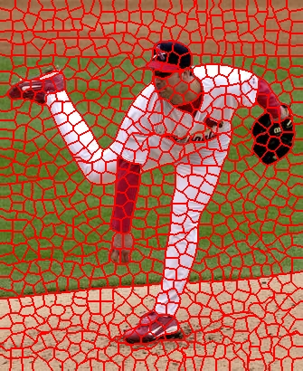
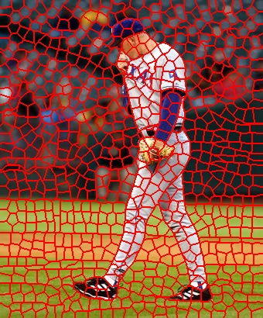
Why would we care to do a segmentation?
Group together similar-looking pixels for efficiency of further processing
“superpixels”
Slide credit: Svetlana Lazebnik
X. Ren and J. Malik. Learning a classification model for segmentation. ICCV 2003.

Slide 5
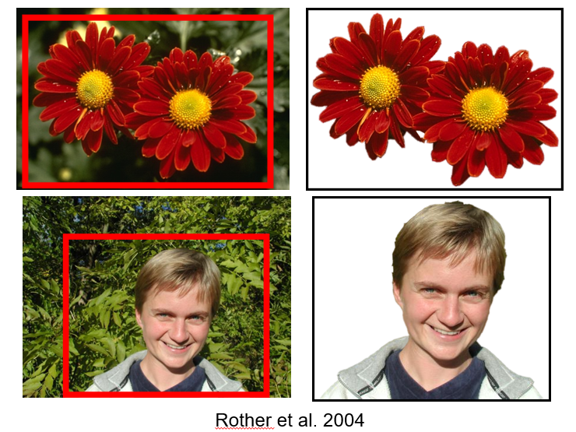
Why would we care to do a segmentation?
Separate the object from the background

Slide 6
One way to think about “Segmentation” is Clustering
Clustering = group together similar data points and represent them with a single token
Key Challenges:
What makes two points/images/patches similar?
How do we compute an overall grouping from pairwise similarities?
So we would like to understand:
How to group ??
Slide: Derek Hoiem

Slide 7
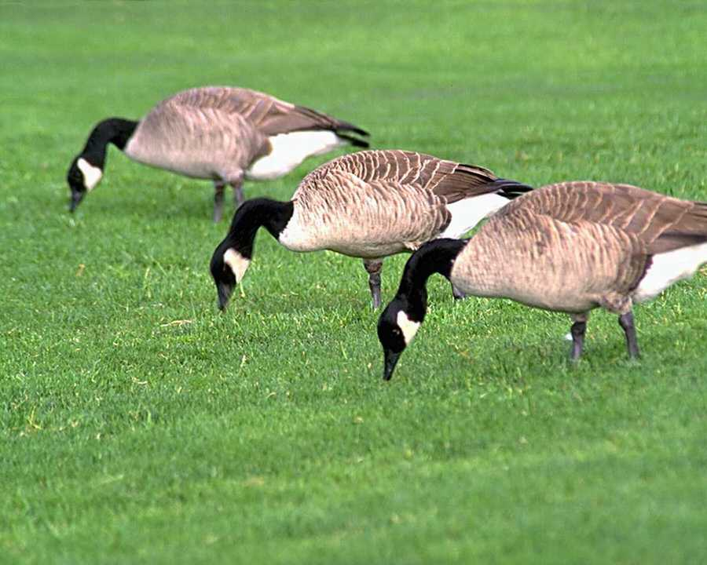
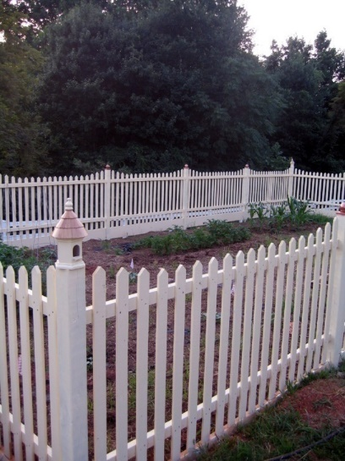
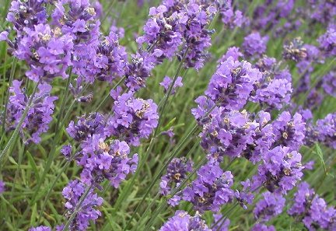
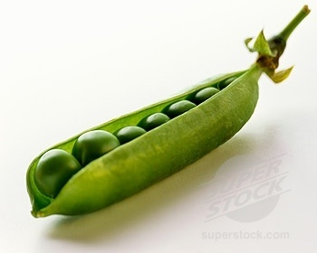
Similarity
Slide credit: Kristen Grauman

Slide 8
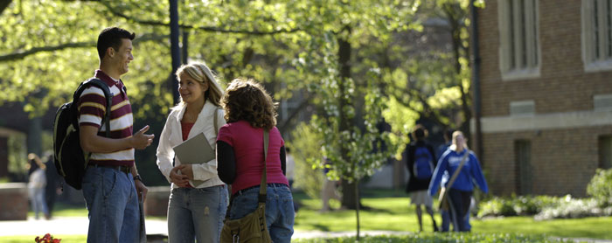

Proximity
Slide credit: Kristen Grauman

Slide 9
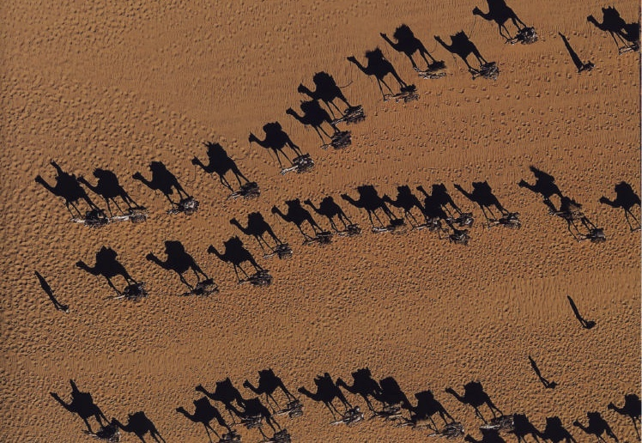
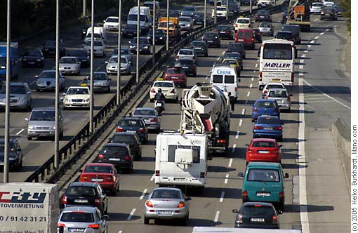
Common Fate
Image credit: Arthus-Bertrand (via F. Durand)
Slide credit: Kristen Grauman

Slide 10
An experiment: What do you see?
Just six dots
Just six dots
S. Birchfield, Clemson Univ., ECE 847, http://www.ces.clemson.edu/~stb/ece847
S. Birchfield, Clemson Univ., ECE 847, http://www.ces.clemson.edu/~stb/ece847

Slide 11
Now what do you see?
Three groups of dot pairs
Why?
Dots that are close together (“proximity”)
are grouped together by the human visual system
S. Birchfield, Clemson Univ., ECE 847, http://www.ces.clemson.edu/~stb/ece847

Slide 12
And now?
Again, three groups of dot pairs
Why?
Dots are similar in appearance (“similarity”)
S. Birchfield, Clemson Univ., ECE 847, http://www.ces.clemson.edu/~stb/ece847

Slide 13
How about now?
Again, three groups of dot pairs
Why?
Dots move similarly (“common fate”)
S. Birchfield, Clemson Univ., ECE 847, http://www.ces.clemson.edu/~stb/ece847

Slide 14
Last one
Again, three groups of dots
Why?
Dots are enclosed together (“common region”)
S. Birchfield, Clemson Univ., ECE 847, http://www.ces.clemson.edu/~stb/ece847

Slide 15
But wait!
Note that the “common region” can overwhelm
the “proximity” tendency
S. Birchfield, Clemson Univ., ECE 847, http://www.ces.clemson.edu/~stb/ece847

Slide 16
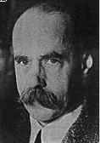
Gestalt Theory of human perception
Gestalt: whole or group
Whole is greater than sum of its parts
Relationships among parts can yield new properties/features
Psychologists identified series of factors that predispose set of elements to be grouped (by human visual system)
“I stand at the window and see a house, trees, sky. Theoretically I might say there were 327 brightnesses and nuances of colour. Do I have "327"? No. I have sky, house, and trees.”
Max Wertheimer (1880-1943)
Untersuchungen zur Lehre von der Gestalt, Psychologische Forschung, Vol. 4, pp. 301-350, 1923
http://psy.ed.asu.edu/~classics/Wertheimer/Forms/forms.htm

Slide 17
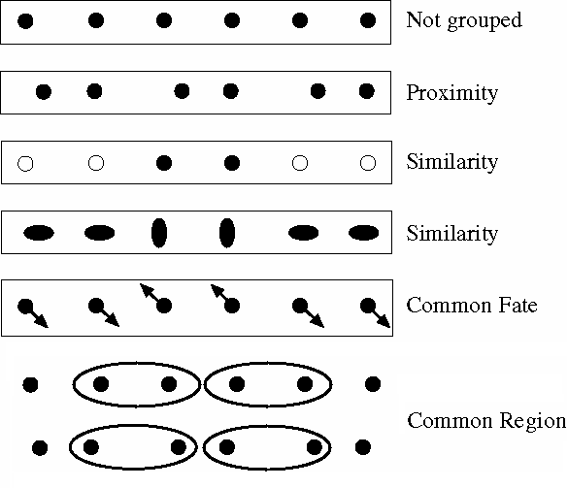
Gestalt psychology
Gestalt school of psychologists emphasized grouping as the key to understanding visual perception
Recall: Context affects
how things are
perceived
gestalt – whole or group
gestalt qualitat – set of internal relationships that makes it a whole
Max Wertheimer, Laws of Organization in Perceptual Forms, 1923
http://psy.ed.asu.edu/~classics/Wertheimer/Forms/forms.htm
S. Birchfield, Clemson Univ., ECE 847, http://www.ces.clemson.edu/~stb/ece847

Slide 18
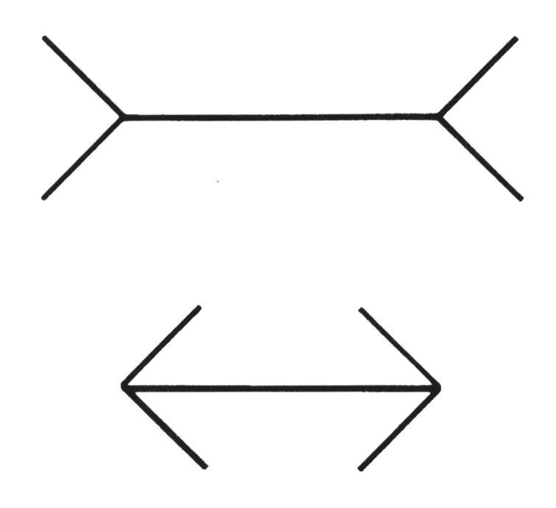
Muller-Lyer illusion
Lines are perceived as components of a whole rather than as individual lines.
S. Birchfield, Clemson Univ., ECE 847, http://www.ces.clemson.edu/~stb/ece847

Slide 19

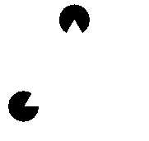
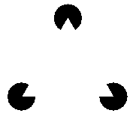
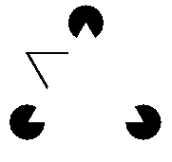
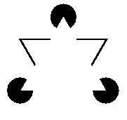

Can you see anything invisible?
These are illusory contours, formed by grouping the circles
This is the well-known Kanizsa triangle
S. Birchfield, Clemson Univ., ECE 847, http://www.ces.clemson.edu/~stb/ece847

Slide 20
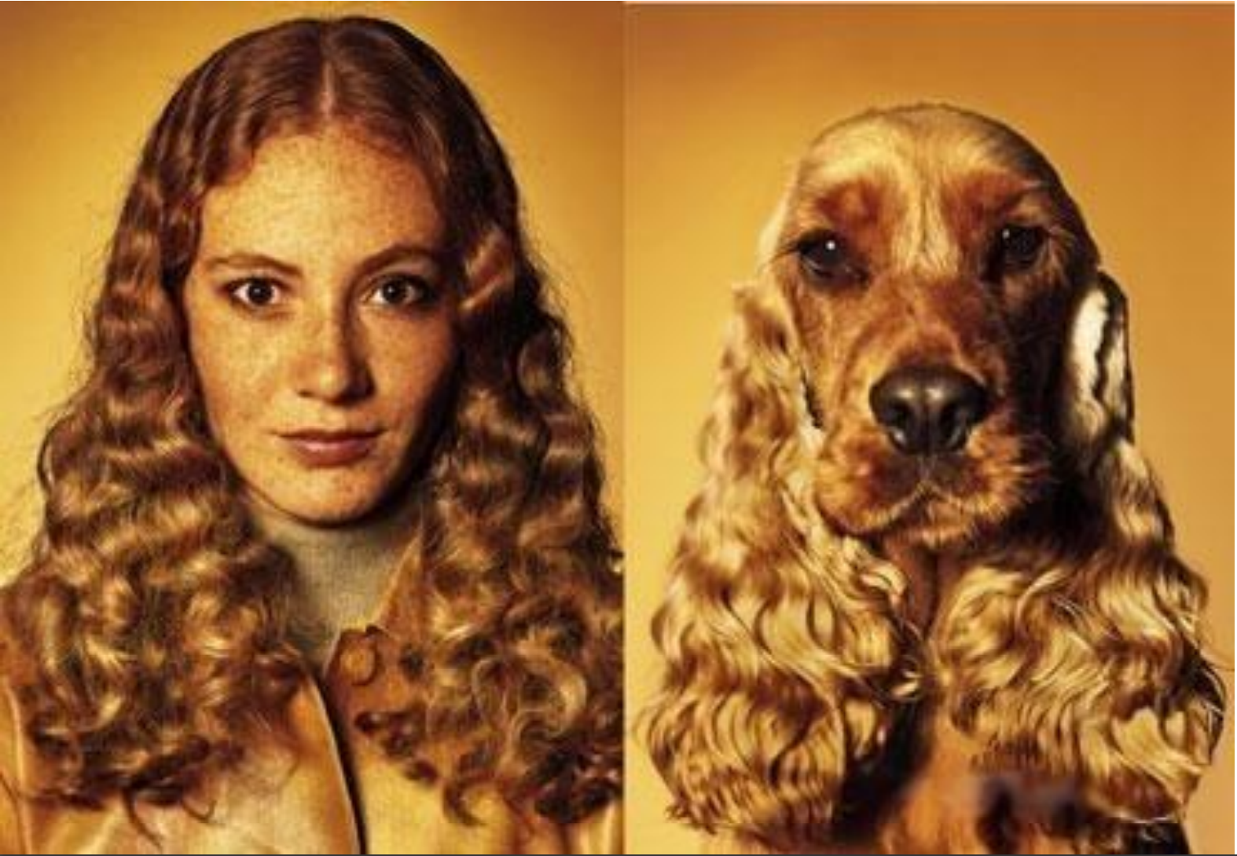
What is similarity?
Similarity is hard to define, but… “We know it when we see it” The real meaning of similarity is a philosophical question. We will take a more pragmatic approach.

Slide 21
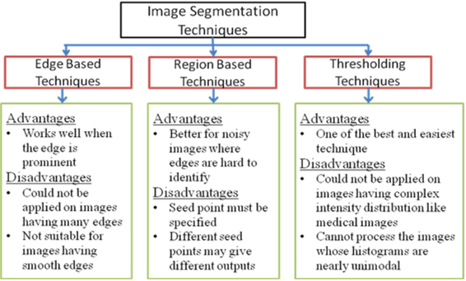
Segmentation methods
Threshold based
Simple histogram thresholding
Otsu thresholding
Edge (or contour) based
Edge detection, Haugh transform
Clustering based
K-means
Region based
Agglomerative clustering – merging (bottom to top)
Divisive clustering – splitting (top to bottom)
Deep learning based

Slide 22
Segmentation methods
Threshold based
Simple histogram thresholding
Otsu thresholding
Edge (or contour) based
Edge detection, Haugh transform
Clustering based
K-means
Region based
Agglomerative clustering – merging (bottom to top)
Divisive clustering – splitting (top to bottom)
Deep learning based

Slide 23
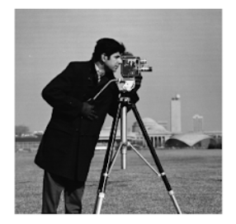
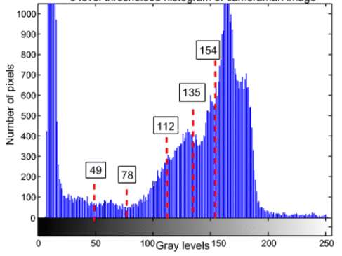
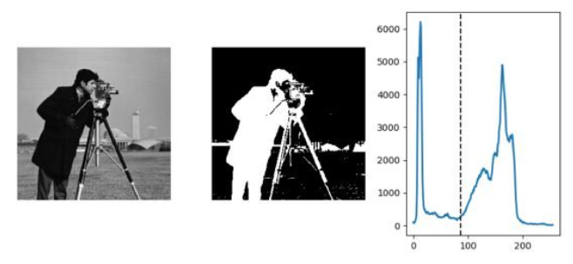
Threshold based
Based on the intensity histogram, the pixels in an image get divided by comparing the pixel’s intensity with a threshold value.
Individual pixels in an image are marked as “object” pixels if their value is greater(smaller) than some threshold value and as “background” pixels otherwise
Typically, an object pixel is given a value of “1” while a background pixel is given a value of “0.”
How to choose the threshold?

Slide 24
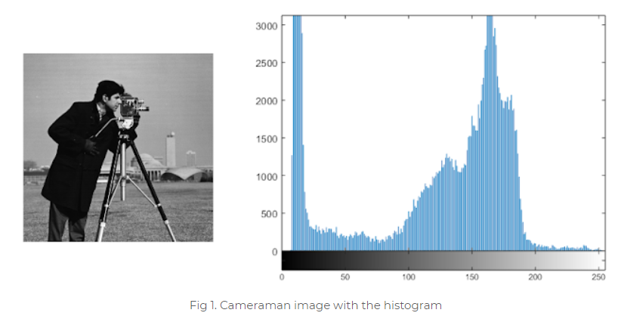
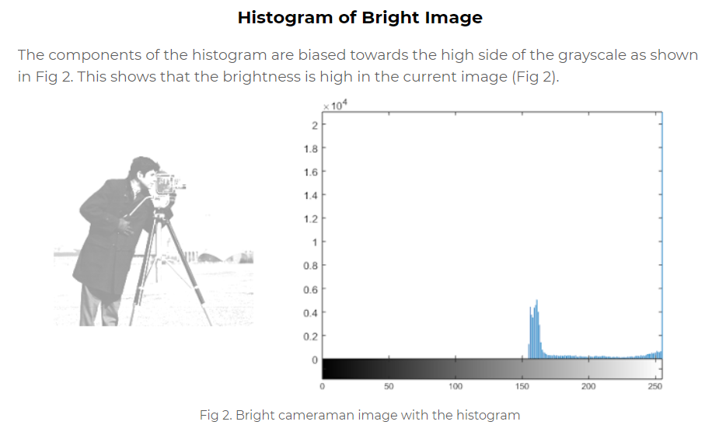
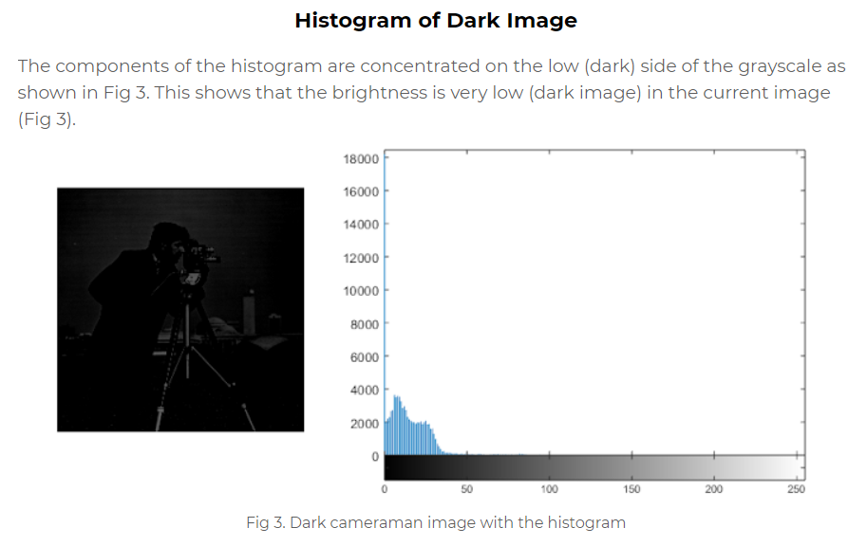
Image histogram analysis: bright vs dark

Slide 25
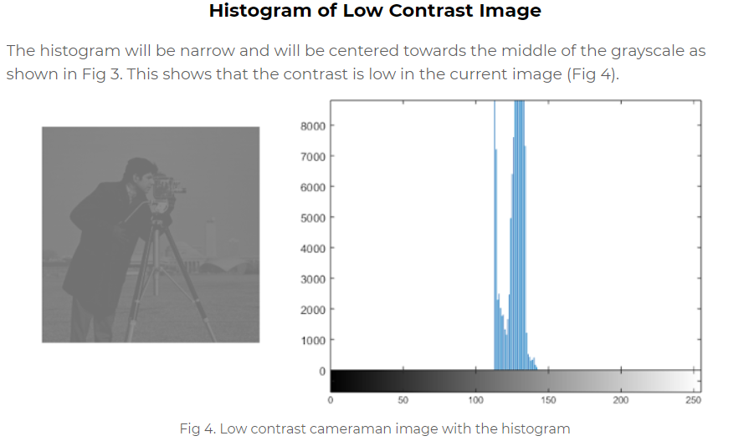
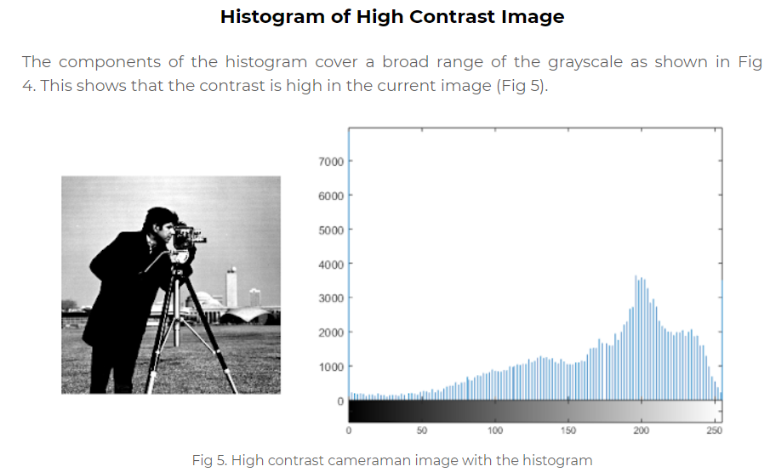
Image histogram analysis: low vs high contrast

Slide 26
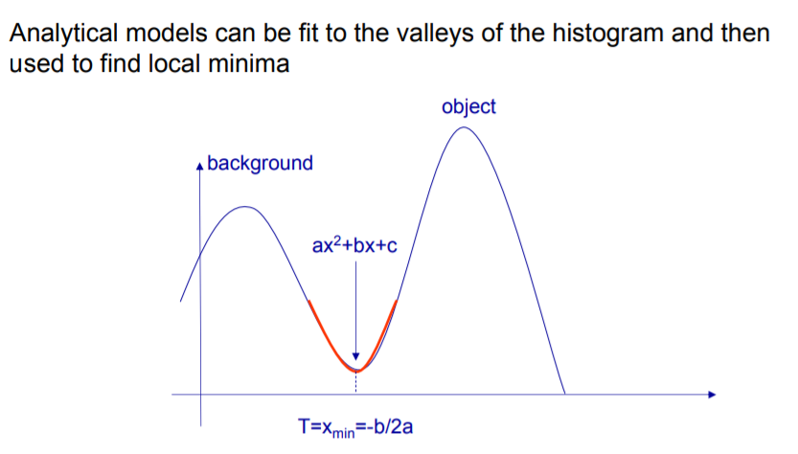
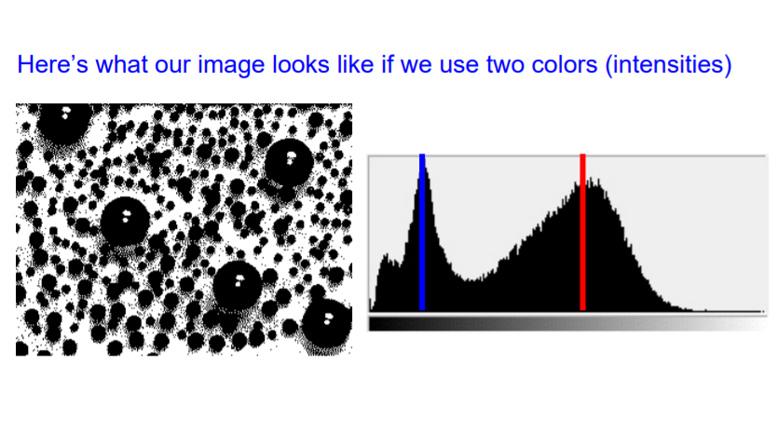
How to compute the threshold?
Peaks, valleys and curvatures of the smoothed histogram are analyzed:
Find minimum
Fit analytical model and find minima (more robust)
Clustering-like method:
Break the image into K regions (segments) by reducing the number of colors to
Assigning each pixel to the closest color

Slide 27
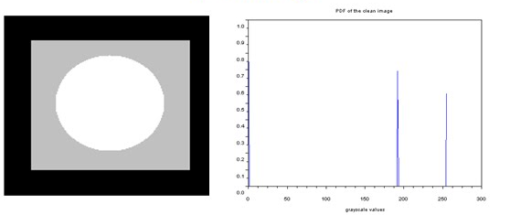
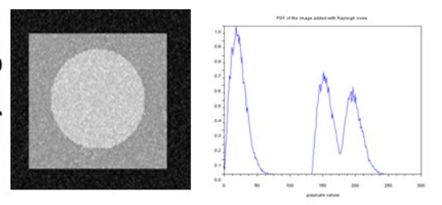
What is the problem with simple (minimum based) thresholding?
Histogram shape analysis
Foreground pixels form one peak
Background pixels form the second peak
Intuitively: the threshold is set as the gray level that has a minimum value between two maxima
Problem: noisy histograms

Slide 28
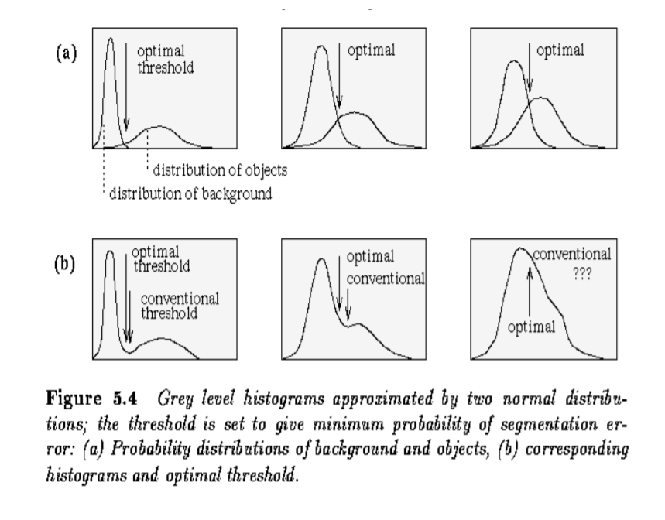
Optimal thresholding
The histogram of an image is the sum of two overlapping distributions
Optimal threshold: overlapping point of these distributions
Problem: distributions are unknown

Slide 29
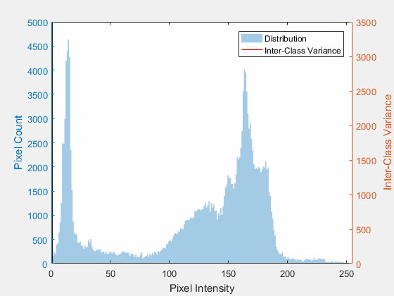
Optimal thresholding : the Otsu method
Otsu’s method is an adaptive thresholding way for binarization in image processing. By going through all possible threshold values (from 0 to 255), it can find the optimal threshold value of input image.
The optimal threshold value is the one so that within-class variance is minimal (or between-class variance is maximal)

Slide 30
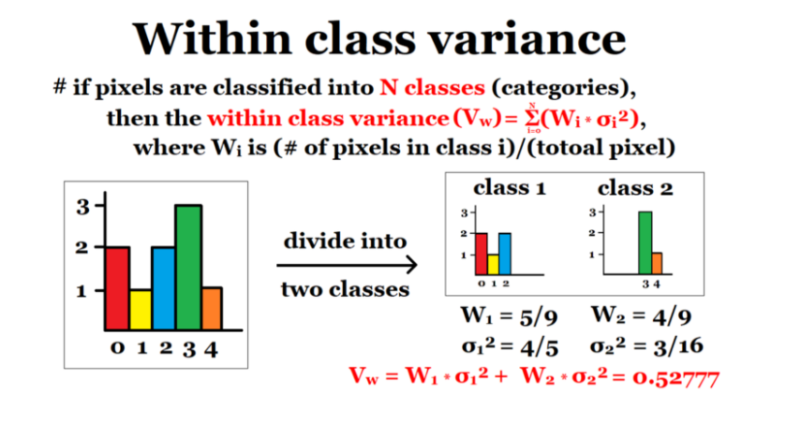
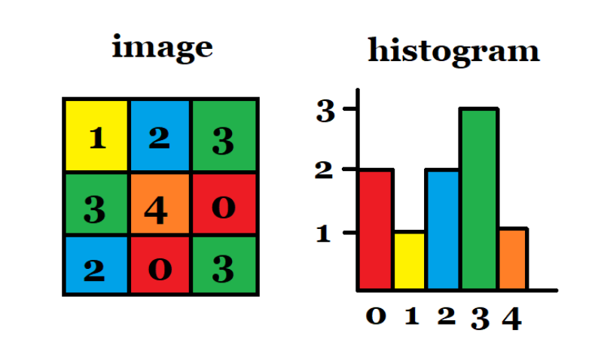
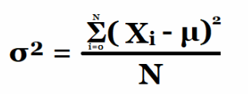
Otsu algorithm
Compute image histogram
For each possible threshold values T=(from 0 to 255):
Separate all pixels to 2 classes: C1: p<T, C2: p>T
Calculate within-class variance.
Calculate between-class variance as
TotalVariance-within class variance
Find T which minimizes within-class variance or maximizes between-class variance

Slide 31
Otsu vs manual result for clean image

Slide 32
Otsu vs manual result for noisy image

Slide 33
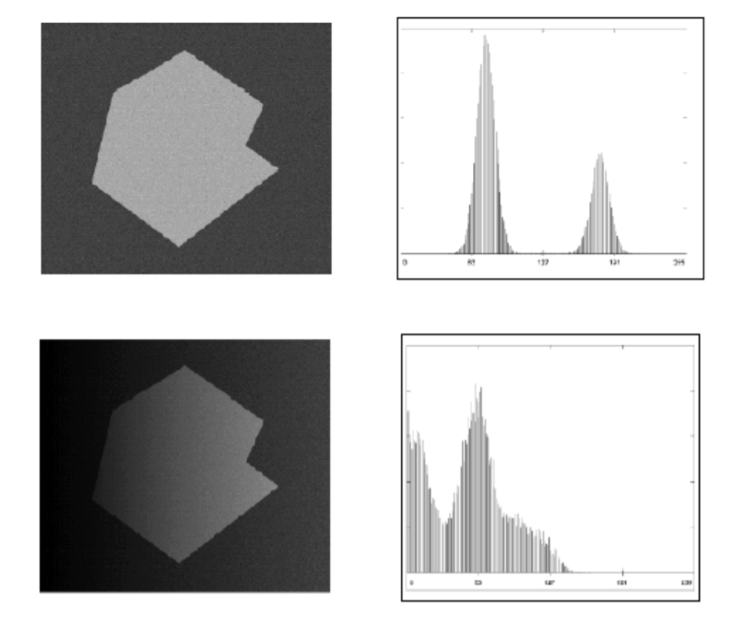
Conclusion: thresholding methods
Good:
Simple to implement
Fast (especially if repeating on similar images)
Good for some kinds of images (e.g., documents, controlled lighting)
Bad:
No guarantees of object coherency - may have holes, extraneous pixels, etc.
Incomplete solution: post-processing with morphological operators

Slide 34
Segmentation methods
Threshold based
Simple histogram thresholding
Otsu thresholding
Edge (or contour) based
Edge detection, Haugh transform
Clustering based
K-means
Region based
Agglomerative clustering – merging (bottom to top)
Divisive clustering – splitting (top to bottom)
Deep learning based

Slide 35
Segmentation methods
Threshold based
Simple histogram thresholding
Otsu thresholding
Edge (or contour) based
Edge detection, Haugh transform
Clustering based
K-means
Region based
Agglomerative clustering – merging (bottom to top)
Divisive clustering – splitting (top to bottom)
Deep learning based

Slide 36

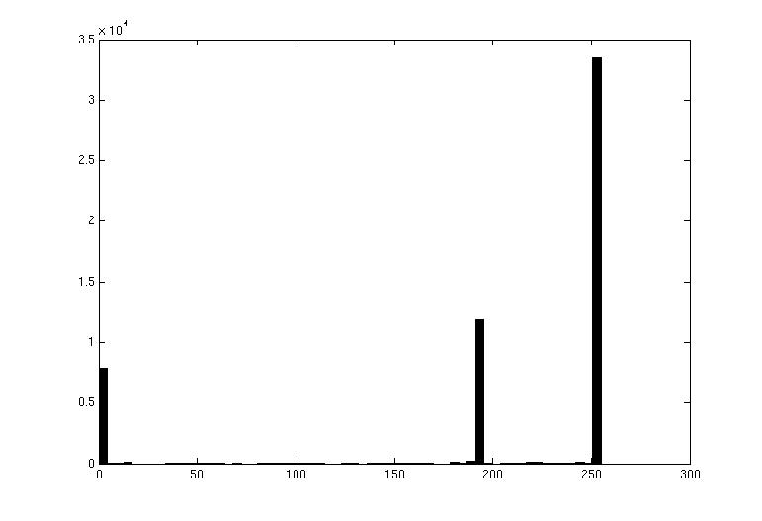
Image Segmentation: Toy Example
3
1
2
white pixels
black pixels
gray pixels
input image
These intensities define the three groups.
We could label every pixel in the image according to which of these primary intensities it is.
i.e., segment the image based on the intensity feature.
What if the image isn’t quite so simple?
intensity
Slide credit: Kristen Grauman

Slide 37
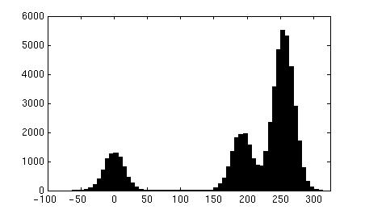
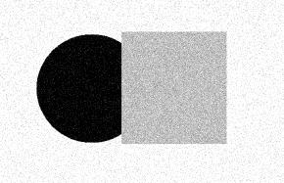
Pixel count
Input image
Intensity
Pixel count
Input image
Intensity
Slide credit: Kristen Grauman

Slide 38
Image Segmentation: Clustering
Pixel count
Input image
Now how to determine the three main intensities that define our groups?
We need to cluster.
Intensity
Slide credit: Kristen Grauman

Slide 39
Goal: choose three “centers” as the representative intensities, and label every pixel according to which of these centers it is nearest to.
Best cluster centers are those that minimize Sum of Square Distance (SSD) between all points and their nearest cluster center c_{i}
0
190
255
Intensity
3
1
2
Slide credit: Kristen Grauman

Slide 40
Clustering
With this objective, it is a “chicken and egg” problem:
If we knew the cluster centers, we could allocate points to groups by assigning each to its closest center.
If we knew the group memberships, we could get the centers by computing the mean per group.
Slide credit: Kristen Grauman
Which clustering algorithm does it remind you?

Slide 41
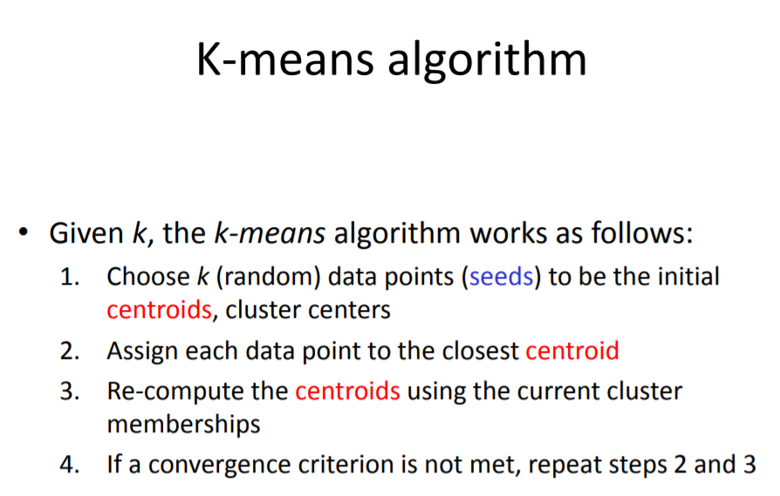
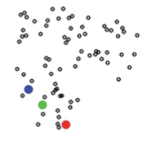
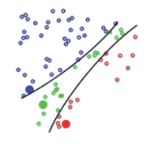
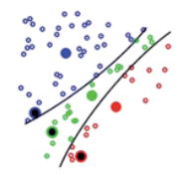
1
2
3

Slide 42

Feature Space
Depending on what we choose as the feature space, we can group pixels in different ways.
Grouping pixels based on intensity similarity
Feature space: intensity value (1D)
Slide credit: Kristen Grauman

Slide 43



Segmentation using k-means
Original image
2 clusters
3 clusters

Slide 44

Smoothing Out Cluster Assignments
Assigning a cluster label per pixel may yield outliers:
How can we ensure they are spatially smooth?
Original
Labeled by cluster center’s intensity
?
3
1
2
Slide credit: Kristen Grauman

Slide 45
Segmentation as Clustering
Depending on what we choose as the feature space, we can group pixels in different ways.
Grouping pixels based on intensity+position similarity
⇒ Way to encode both similarity and proximity.
Intensity
Y
X
Slide credit: Kristen Grauman
Notes:
Both regions are black, but if we also include position (x,y), then we could group the two into distinct segments; way to encode both similarity & proximity.

Slide 46



K-Means Clustering Results
K-means clustering based on intensity or color is essentially vector quantization of the image attributes (Clusters don’t have to be spatially coherent)
Image
Intensity-based clusters
Color-based clusters
Image source: Forsyth & Ponce

Slide 47


How to choose K: the elbow method
Calculate the Within-Cluster-Sum of Squared Errors (WSS) for different values of K, and choose the K for which WSS becomes first starts to diminish. In the plot of WSS-versus-k, this is visible as an elbow.
Within-Cluster-Sum of Squared Errors sounds a bit complex. Let’s break it down:
The Squared Error for each point is the square of the distance of the point from its representation i.e. its predicted cluster center.
The WSS score is the sum of these Squared Errors for all the points.
Any distance metric like the Euclidean Distance or the Manhattan Distance can be used.
As expected, the plot looks like an arm with a clear elbow at k = 3.

Slide 48

Seed Choice
Sec. 16.4
Results can vary based on random seed selection.
Some seeds can result in poor convergence rate, or convergence to sub-optimal clusters
Select good seeds using a heuristic (e.g., doc least similar to any existing mean)
Try out multiple starting points
Initialize with the results of another method.

Slide 49
Conclusions: k-means
Good
Simple, fast to compute
Converges to local minimum of within-cluster squared error
Bad
Setting k?
Sensitive to initial centers
Sensitive to outliers
Detects spherical clusters
Assuming means can be computed

Slide 50
Segmentation methods
Threshold based
Simple histogram thresholding
Otsu thresholding
Edge (or contour) based
Edge detection, Haugh transform
Clustering based
K-means
Region based
Agglomerative clustering – merging (bottom to top)
Divisive clustering – splitting (top to bottom)
Deep learning based

Slide 51
Segmentation as partitioning
A partition of image is collection of sets S₁, .., S_{N} such that
I = S₁ U S₂ … U S_{N} (sets cover entire image)
S_{i} ∩ S_{j} = 0 for all i ≠ j (sets do not overlap)
A predicate H(S_{i}) measures region homogeneity H( R ) = true if pixels in region R are similar false otherwise
We want
Regions to be homogeneous H( S_{i} ) = true for all i
Adjacent regions to be different from each other H( S_{i} U S_{j} ) = false for all adjacent S_{i} , S_{j}
{
S. Birchfield, Clemson Univ., ECE 847, http://www.ces.clemson.edu/~stb/ece847

Slide 52
Two approaches
Splitting (Divisive clustering)
start with single region covering entire image
repeat: split inhomogeneous regions
even better: repeat: split cluster to yield two distant components (difficult)
Property 2 is always true: H( S_{i} U S_{j} ) = false for adjacent regions
Goal is to satisfy Property 1:
H( S_{i} ) = true for every region
Merging (Agglomerative clustering)
start with each pixel as a separate region
repeat: merge adjacent regions if union is homogeneous
even better: repeat: merge two closest clusters
Property 1 is always true: H( S_{i} ) = true for every region
Goal is to satisfy Property 2:
H( S_{i} U S_{j} ) = false for adjacent regions
In practice, merging works much
better than splitting
S. Birchfield, Clemson Univ., ECE 847, http://www.ces.clemson.edu/~stb/ece847

Slide 53

Divisive vs Agglomerative

Slide 54




Dendrograms
Dendrogram yields a picture of output as clustering process continues
raw data
clusters represented as tree
from http://en.wikipedia.org/wiki/Dendrogram
S. Birchfield, Clemson Univ., ECE 847, http://www.ces.clemson.edu/~stb/ece847

Slide 55

Agglomerative clustering algorithm

Slide 56

Linkage Methods of Clustering
Single Linkage
Minimum Distance
Cluster 1
Cluster 2
Complete Linkage
Maximum Distance
Cluster 1
Cluster 2
Average Linkage
Average Distance
Cluster 1
Cluster 2

Slide 57

Agglomerative clustering results
How to define cluster similarity?
Average distance between points,
maximum distance
minimum distance
How many clusters?
Clustering creates a dendrogram (a tree)
Threshold based on max number of clusters or based on distance between merges
distance

Slide 58
Conclusions: Agglomerative Clustering
Good
Simple to implement, widespread application.
Clusters have adaptive shapes.
Provides a hierarchy of clusters.
No need to specify number of clusters in advance.
Bad
May have imbalanced clusters.
Still have to choose number of clusters or threshold.
Does not scale well. Runtime of O(n³).
Can get stuck at a local optima.

Slide 59
Conducting Cluster/Segmentation
Formulate the Problem
Select a Distance Measure
Select a Clustering Procedure
Decide on the Number of Clusters
Interpret and Profile Clusters
Assess the Validity of Clustering

Slide 60
Formulating the Problem
Most important is selecting the variables on which the clustering is based.
Inclusion of even one or two irrelevant variables may distort a clustering solution.
Variables selected should describe the similarity between objects in terms that are relevant to the marketing research problem.
Should be selected based on past research, theory, or a consideration of the hypotheses being tested.

Slide 61
Select a Similarity Measure
Similarity measure can be correlations or distances
The most commonly used measure of similarity is the Euclidean distance. The city-block distance is also used.
If variables measured in vastly different units, we must standardize data. Also eliminate outliers
Use of different similarity/distance measures may lead to different clustering results.
Hence, it is advisable to use different measures and compare the results.

Slide 62
Decide Number of Clusters
Theoretical, conceptual, or practical considerations.
In hierarchical clustering, the distances at which clusters are combined (from agglomeration schedule) can be used
Stop when similarity measure value makes sudden jumps between steps
In nonhierarchical clustering, the ratio of total within-group variance to between-group variance can be plotted against the number of clusters.
The relative sizes of the clusters should be meaningful.

Slide 63
Assess Reliability and Validity
Perform cluster analysis on the same data using different distance measures. Compare the results across measures to determine the stability of the solutions.
Use different methods of clustering and compare the results.
Split the data randomly into halves. Perform clustering separately on each half. Compare cluster centroids across the two subsamples.
Delete variables randomly. Perform clustering based on the reduced set of variables. Compare the results with those obtained by clustering based on the entire set of variables.

Slide 64
Summary
So we learned today:
Why image segmentation is important
How humans group (segment the objects)
Segmentation methods:
Threshold based
K-means
Region based
Steps to conduct the segmatiation

Slide 65


Slide 66

Thank you!

